Slide 1

Chapter 3 Transport Layer
A note on the use of these PowerPoint slides:
We’re making these slides freely available to all (faculty, students, readers). They’re in PowerPoint form so you see the animations; and can add, modify, and delete slides (including this one) and slide content to suit your needs. They obviously represent a lot of work on our part. In return for use, we only ask the following:
If you use these slides (e.g., in a class) that you mention their source (after all, we’d like people to use our book!)
If you post any slides on a www site, that you note that they are adapted from (or perhaps identical to) our slides, and note our copyright of this material.
For a revision history, see the slide note for this page.
Thanks and enjoy! JFK/KWR
All material copyright 1996-2023
J.F Kurose and K.W. Ross, All Rights Reserved
Computer Networking: A Top-Down Approach 8th edition Jim Kurose, Keith Ross Pearson, 2020
Notes:
Version History
8.0 (April 2020)
All slides reformatted for 16:9 aspect ratio
All slides updated to 8th edition material
Use of Calibri font, rather that Gill Sans MT
Add LOTS more animation throughout
added new 8th edition material on QUIC, CUBIC, delay-based congestion control
lighter header font
8.2 (July 2023): changes from 8.0
minor updates throughout, but not much changes from 8.0

Slide 2
Transport layer: overview
Our goal:
understand principles behind transport layer services:
multiplexing, demultiplexing
reliable data transfer
flow control
congestion control
learn about Internet transport layer protocols:
UDP: connectionless transport
TCP: connection-oriented reliable transport
TCP congestion control

Slide 3

Transport layer: roadmap
Transport-layer services
Multiplexing and demultiplexing
Connectionless transport: UDP
Principles of reliable data transfer
Connection-oriented transport: TCP
Principles of congestion control
TCP congestion control
Evolution of transport-layer functionality

Slide 4








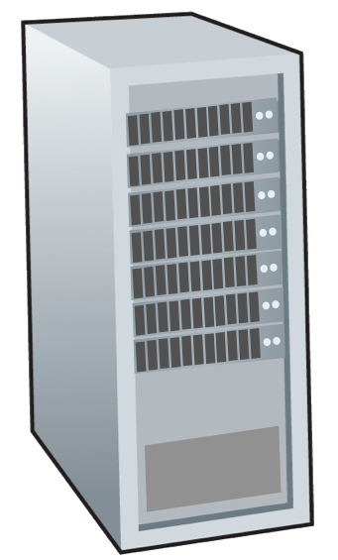







Transport services and protocols
application
transport
network
data link
physical
provide logical communication between application processes running on different hosts
mobile network
national or global ISP
transport protocols actions in end systems:
sender: breaks application messages into segments, passes to network layer
receiver: reassembles segments into messages, passes to application layer
logical end-end transport
local or regional ISP
home network
content
provider
network
application
transport
network
data link
physical
datacenter
network
two transport protocols available to Internet applications
TCP, UDP
enterprise
network
Notes:
By logical communication , we
mean that from an application’s perspective, it is as if the hosts running the processes
were directly connected; in reality, the hosts may be on opposite sides of the
planet, connected via numerous routers and a wide range of link types. Application
processes use the logical communication provided by the transport layer to send
messages to each other, free from the worry of the details of the physical infrastructure
used to carry these messages.
Let’s look at each of these three (logical communications, actions,

Slide 5
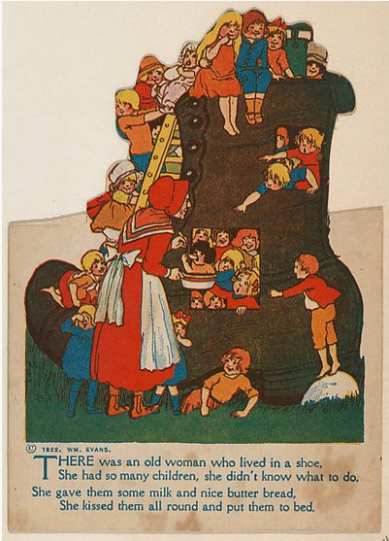
Transport vs. network layer services and protocols
household analogy:
12 kids in Ann’s house sending letters to 12 kids in Bill’s house:
hosts = houses
processes = kids
app messages = letters in envelopes
transport protocol = Ann and Bill who demux to in-house siblings
network-layer protocol = postal service

Slide 6
Transport vs. network layer services and protocols
household analogy:
transport layer: communication between processes
relies on, enhances, network layer services
12 kids in Ann’s house sending letters to 12 kids in Bill’s house:
hosts = houses
processes = kids
app messages = letters in envelopes
transport protocol = Ann and Bill who demux to in-house siblings
network-layer protocol = postal service
network layer: communication between hosts

Slide 7
Transport Layer Actions
Sender:
application
application
is passed an application-layer message
app. msg
determines segment header fields values
T_{h}
transport
app. msg
transport
T_{h}
creates segment
network (IP)
network (IP)
passes segment to IP
link
link
physical
physical

Slide 8
Transport Layer Actions
Receiver:
application
receives segment from IP
application
checks header values
transport
transport
app. msg
extracts application-layer message
network (IP)
network (IP)
demultiplexes message up to application via socket
link
link
physical
physical
app. msg
T_{h}

Slide 9
Two principal Internet transport protocols
application
transport
network
data link
physical
TCP: Transmission Control Protocol
reliable, in-order delivery
congestion control
flow control
connection setup
UDP: User Datagram Protocol
unreliable, unordered delivery
no-frills extension of “best-effort” IP
services not available:
delay guarantees
bandwidth guarantees
mobile network
national or global ISP
logical end-end transport
local or regional ISP
home network
content
provider
network
application
transport
network
data link
physical
datacenter
network
enterprise
network

Slide 10
Chapter 3: roadmap
Transport-layer services
Multiplexing and demultiplexing
Connectionless transport: UDP
Principles of reliable data transfer
Connection-oriented transport: TCP
Principles of congestion control
TCP congestion control
Evolution of transport-layer functionality

Slide 11

Multiplexing/demultiplexing
multiplexing as sender:
demultiplexing as receiver:
handle data from multiple
sockets, add transport header (later used for demultiplexing)
use header info to deliver
received segments to correct
socket
application
application
P1
P2
application
socket
P3
transport
P4
process
transport
network
transport
network
link
network
link
physical
link
physical
physical

Slide 12




HTTP server
client
application
application
HTTP msg
transport
H_{t}
HTTP msg
H_{n}
H_{t}
network
transport
HTTP msg
transport
H_{n}
H_{t}
link
network
network
HTTP msg
link
physical
link
physical
physical
H_{n}
H_{t}
HTTP msg

Slide 13

Q: how did transport layer know to deliver message to Firefox browser process rather then Netflix process or Skype process?
client
application
application
HTTP msg
HTTP msg
transport
H_{t}
HTTP msg
transport
network
transport
network
link
network
link
physical
link
physical
physical

Slide 14
?
de-multiplexing

Slide 15
application
?
transport
de-multiplexing

Slide 16
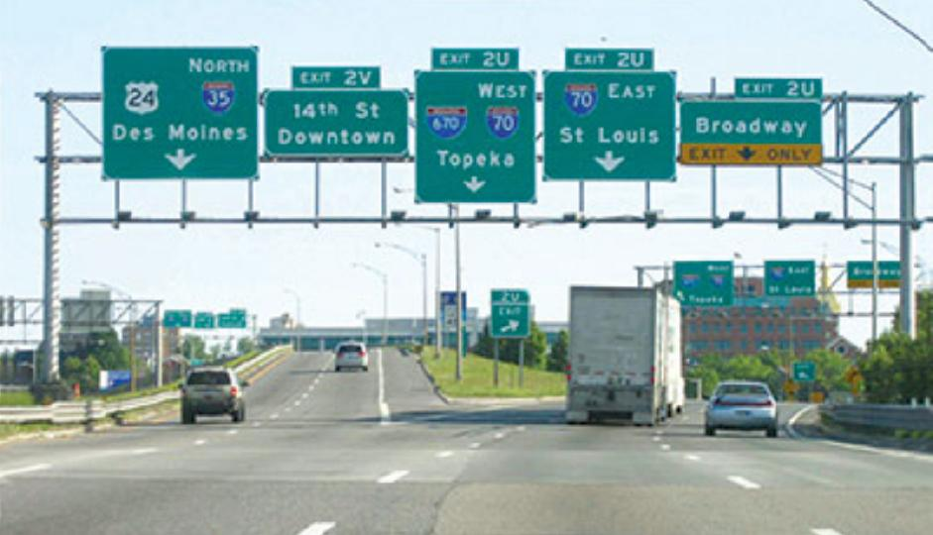
Demultiplexing

Slide 17
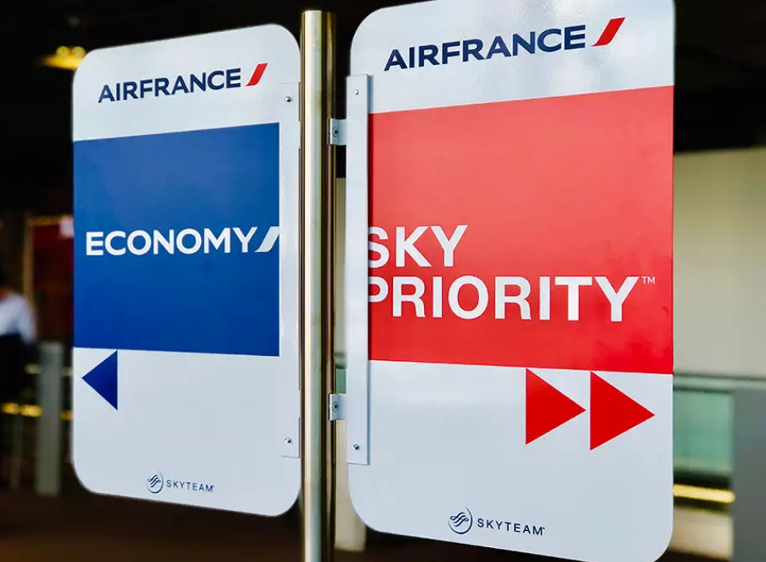

Slide 18
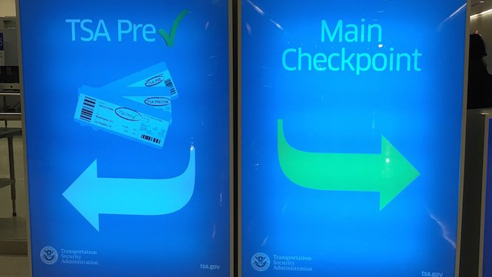

Slide 19
multiplexing

Slide 20
application
transport
multiplexing

Slide 21
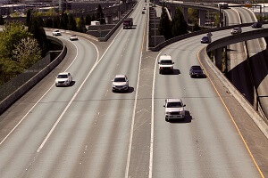
Multiplexing

Slide 22
How demultiplexing works
host receives IP datagrams
each datagram has source IP address, destination IP address
each datagram carries one transport-layer segment
each segment has source, destination port number
host uses IP addresses & port numbers to direct segment to appropriate socket
32 bits
source port #
dest port #
other header fields
application
data
(payload)
TCP/UDP segment format

Slide 23
Connectionless demultiplexing
Recall:
when creating socket, must specify host-local port #:
DatagramSocket mySocket1 = new DatagramSocket(12534);
when receiving host receives UDP segment:
checks destination port # in segment
directs UDP segment to socket with that port #
when creating datagram to send into UDP socket, must specify
destination IP address
destination port #
IP/UDP datagrams with same dest. port #, but different source IP addresses and/or source port numbers will be directed to same socket at receiving host

Slide 24
Connectionless demultiplexing: an example
mySocket = socket(AF_INET,SOCK_DGRAM)
mySocket.bind(myaddr,6428);
mySocket = socket(AF_INET,SOCK_STREAM)
mySocket.bind(myaddr,9157);
mySocket = socket(AF_INET,SOCK_STREAM)
mySocket.bind(myaddr,5775);
application
application
P1
application
P3
P4
transport
transport
network
transport
network
link
network
link
physical
link
physical
physical
B
D
source port: 6428
dest port: 9157
source port: ?
dest port: ?
A
C
source port: 9157
dest port: 6428
source port: ?
dest port: ?

Slide 25
Connection-oriented demultiplexing
TCP socket identified by 4-tuple:
source IP address
source port number
dest IP address
dest port number
server may support many simultaneous TCP sockets:
each socket identified by its own 4-tuple
each socket associated with a different connecting client
demux: receiver uses all four values (4-tuple) to direct segment to appropriate socket

Slide 26
Connection-oriented demultiplexing: example
application
application
P4
P5
P6
application
P1
P2
P3
transport
transport
network
transport
network
link
network
link
physical
link
physical
server: IP address B
physical
host: IP address A
source IP,port: B,80
dest IP,port: A,9157
host: IP address C
source IP,port: C,5775
dest IP,port: B,80
source IP,port: A,9157
dest IP, port: B,80
source IP,port: C,9157
dest IP,port: B,80
Three segments, all destined to IP address: B,
dest port: 80 are demultiplexed to different sockets

Slide 27
Summary
Multiplexing, demultiplexing: based on segment, datagram header field values
UDP: demultiplexing using destination port number (only)
TCP: demultiplexing using 4-tuple: source and destination IP addresses, and port numbers
Multiplexing/demultiplexing happen at all layers

Slide 28
Chapter 3: roadmap
Transport-layer services
Multiplexing and demultiplexing
Connectionless transport: UDP
Principles of reliable data transfer
Connection-oriented transport: TCP
Principles of congestion control
TCP congestion control
Evolution of transport-layer functionality

Slide 29
UDP: User Datagram Protocol
Why is there a UDP?
“no frills,” “bare bones” Internet transport protocol
“best effort” service, UDP segments may be:
lost
delivered out-of-order to app
no connection establishment (which can add RTT delay)
simple: no connection state at sender, receiver
small header size
no congestion control
UDP can blast away as fast as desired!
can function in the face of congestion
connectionless:
no handshaking between UDP sender, receiver
each UDP segment handled independently of others

Slide 30
UDP: User Datagram Protocol
UDP use:
streaming multimedia apps (loss tolerant, rate sensitive)
DNS
SNMP
HTTP/3
if reliable transfer needed over UDP (e.g., HTTP/3):
add needed reliability at application layer
add congestion control at application layer

Slide 31
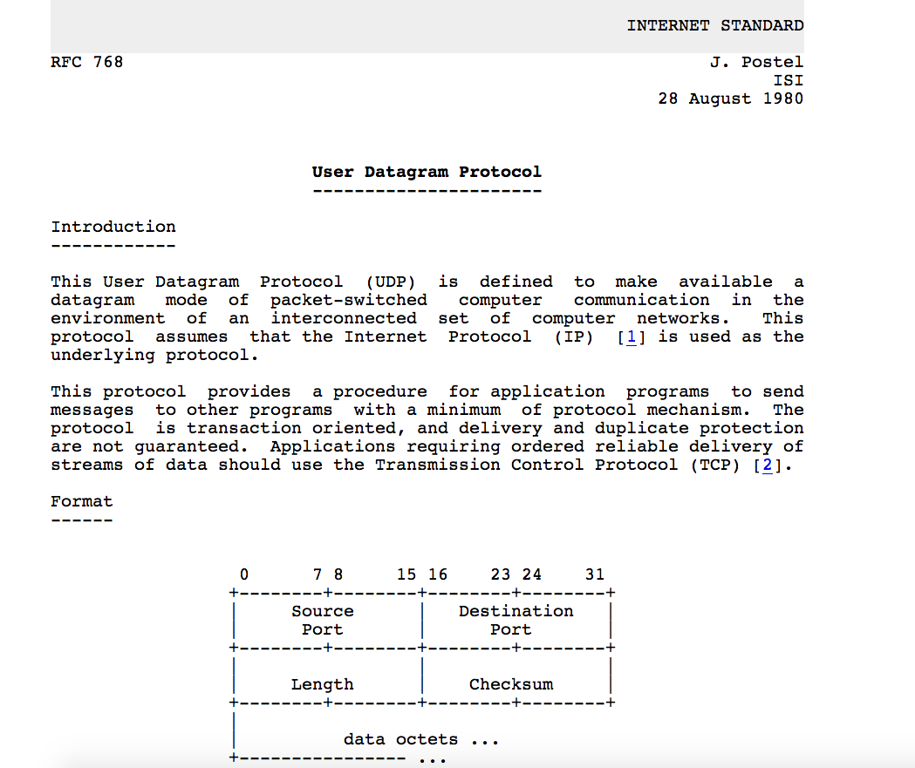
UDP: User Datagram Protocol [RFC 768]
Notes:
read this RFC – it’s only 2.5 pages!

Slide 32
UDP: Transport Layer Actions
SNMP client
SNMP server
application
application
transport
(UDP)
transport
(UDP)
network (IP)
network (IP)
link
link
physical
physical

Slide 33
UDP: Transport Layer Actions
SNMP client
SNMP server
UDP sender actions:
application
application
is passed an application-layer message
SNMP msg
transport
(UDP)
transport
(UDP)
determines UDP segment header fields values
UDP_{h}
SNMP msg
UDP_{h}
creates UDP segment
network (IP)
network (IP)
passes segment to IP
link
link
physical
physical

Slide 34
UDP: Transport Layer Actions
SNMP client
SNMP server
UDP receiver actions:
application
receives segment from IP
application
checks UDP checksum header value
transport
(UDP)
transport
(UDP)
SNMP msg
extracts application-layer message
network (IP)
network (IP)
SNMP msg
UDP_{h}
demultiplexes message up to application via socket
link
link
physical
physical

Slide 35
UDP segment header
32 bits
source port #
dest port #
length
checksum
application
data
(payload)
length, in bytes of UDP segment, including header
data to/from application layer
UDP segment format

Slide 36

UDP checksum
Goal: detect errors (i.e., flipped bits) in transmitted segment
1st number
2nd number
sum
Transmitted: 5 6 11
Received: 4 6 11
receiver-computed
checksum
=
sender-computed
checksum (as received)

Slide 37
Internet checksum
Goal: detect errors (i.e., flipped bits) in transmitted segment
sender:
treat contents of UDP segment (including UDP header fields and IP addresses) as sequence of 16-bit integers
checksum: addition (one’s complement sum) of segment content
checksum value put into UDP checksum field
receiver:
compute checksum of received segment
check if computed checksum equals checksum field value:
not equal - error detected
equal - no error detected. But maybe errors nonetheless? More later ….

Slide 38
Internet checksum: an example
example: add two 16-bit integers
1 1 1 0 0 1 1 0 0 1 1 0 0 1 1 0
1 1 0 1 0 1 0 1 0 1 0 1 0 1 0 1
wraparound
1 1 0 1 1 1 0 1 1 1 0 1 1 1 0 1 1
sum
1 0 1 1 1 0 1 1 1 0 1 1 1 1 0 0
checksum
0 1 0 0 0 1 0 0 0 1 0 0 0 0 1 1
Note: when adding numbers, a carryout from the most significant bit needs to be added to the result
* Check out the online interactive exercises for more examples: http://gaia.cs.umass.edu/kurose_ross/interactive/

Slide 39
Internet checksum: weak protection!
example: add two 16-bit integers
0 1
1 1 1 0 0 1 1 0 0 1 1 0 0 1 1 0
1 0
1 1 0 1 0 1 0 1 0 1 0 1 0 1 0 1
wraparound
1 1 0 1 1 1 0 1 1 1 0 1 1 1 0 1 1
Even though numbers have changed (bit flips), no change in checksum!
sum
1 0 1 1 1 0 1 1 1 0 1 1 1 1 0 0
checksum
0 1 0 0 0 1 0 0 0 1 0 0 0 0 1 1

Slide 40
Summary: UDP
“no frills” protocol:
segments may be lost, delivered out of order
best effort service: “send and hope for the best”
UDP has its plusses:
no setup/handshaking needed (no RTT incurred)
can function when network service is compromised
helps with reliability (checksum)
build additional functionality on top of UDP in application layer (e.g., HTTP/3)

